Slide 1
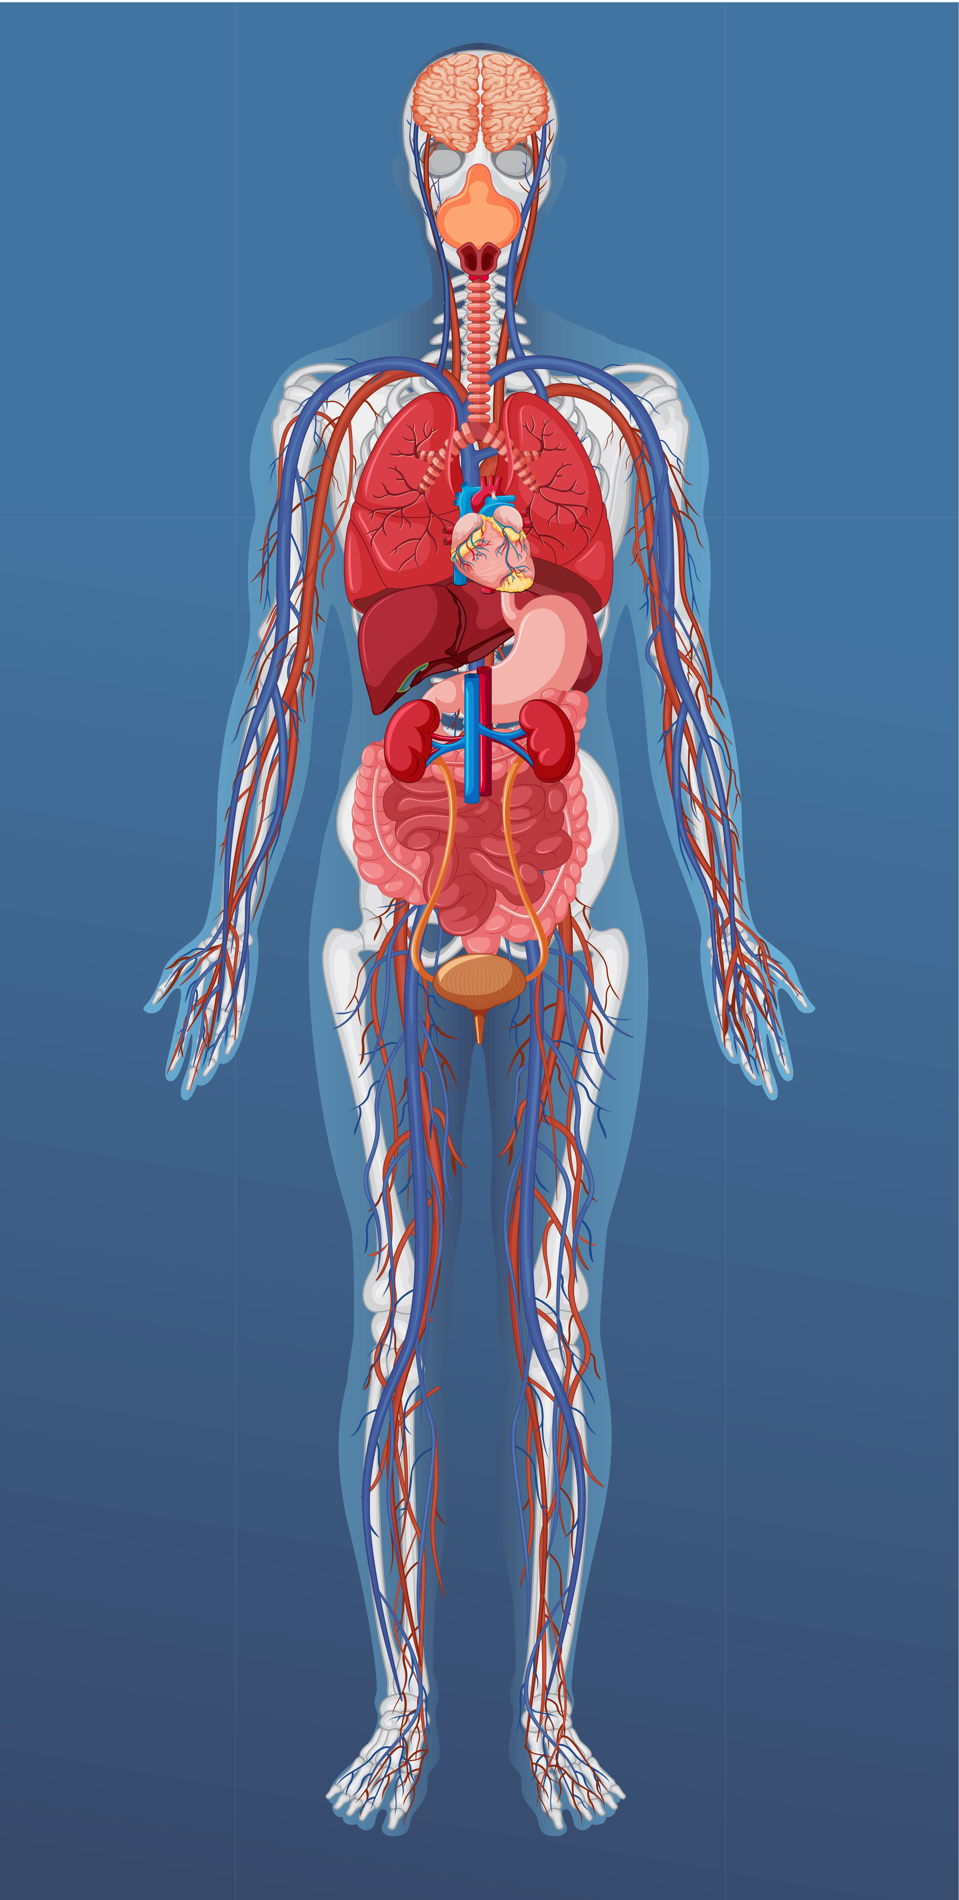
Complications of Shock
A Cascade Through
Seven Systems
Kasia and Ashley
BSN Program Year 3

Slide 2
Categories of Shock
Cardiogenic
Hypovolemic
Distributive
Obstructive
Stages of Shock
Initial - ↑ Lactic acid from ↓ tissue perfusion
Compensatory – Attempt homeostasis
Progressive – Compensation fails
Refractory – Recovery unlikely

Slide 3







Cardiovascular System
Clinical Manifestations:
Compensatory Stage – Tachycardia, ↑ contractility, narrowed pulse pressure
Progressive Stage – ↓ BP (MAP <60), dysrhythmias, myocardial ischemia, ↑ capillary permeability
Refractory Stage – Hypotension, Bradycardia, Poor CO

Slide 4
Respiratory System
Clinical Manifestations:
Compensatory Stage – Tachypnea (hyperventilation to blow off CO₂)
Progressive Stage – ARDS: Acute respiratory distress syndrome (capillary permeability, pulmonary edema, moist crackles, ↓ compliance)
Refractory Stage – Refractory hypoxemia, respiratory failure

Slide 5
Gastrointestinal System
Clinical Manifestations:
Compensatory Stage – ↓ Motility, hypoactive bowel sounds, paralytic ileus risk
Progressive Stage – Ischemic gut, stress ulcers, GI bleeding, bacterial translocation
Refractory Stage – Irreversible Ischemia

Slide 6
Hepatic System
Clinical Manifestations:
Compensatory Stage – Decreased perfusion.
Progressive Stage – ↑ Liver enzymes, cell death, jaundice
Refractory Stage – ↑ NH₃, ↑ lactate → worsening acidosis

Slide 7
Neurological System
Clinical Manifestations:
Compensatory Stage – Anxiety, restlessness, confusion
Progressive Stage – ↓ Responsiveness, delirium
Refractory Stage – Unresponsive, areflexia, fixed dilated pupils

Slide 8
Renal System
Clinical Manifestations:
Compensatory Stage – RAAS activation → conserve Na⁺/H₂O, ↑ BP
Progressive Stage – Acute tubular necrosis, oliguria, Metabolic acidosis.
Refractory Stage – Anuria (kidney failure)

Slide 9
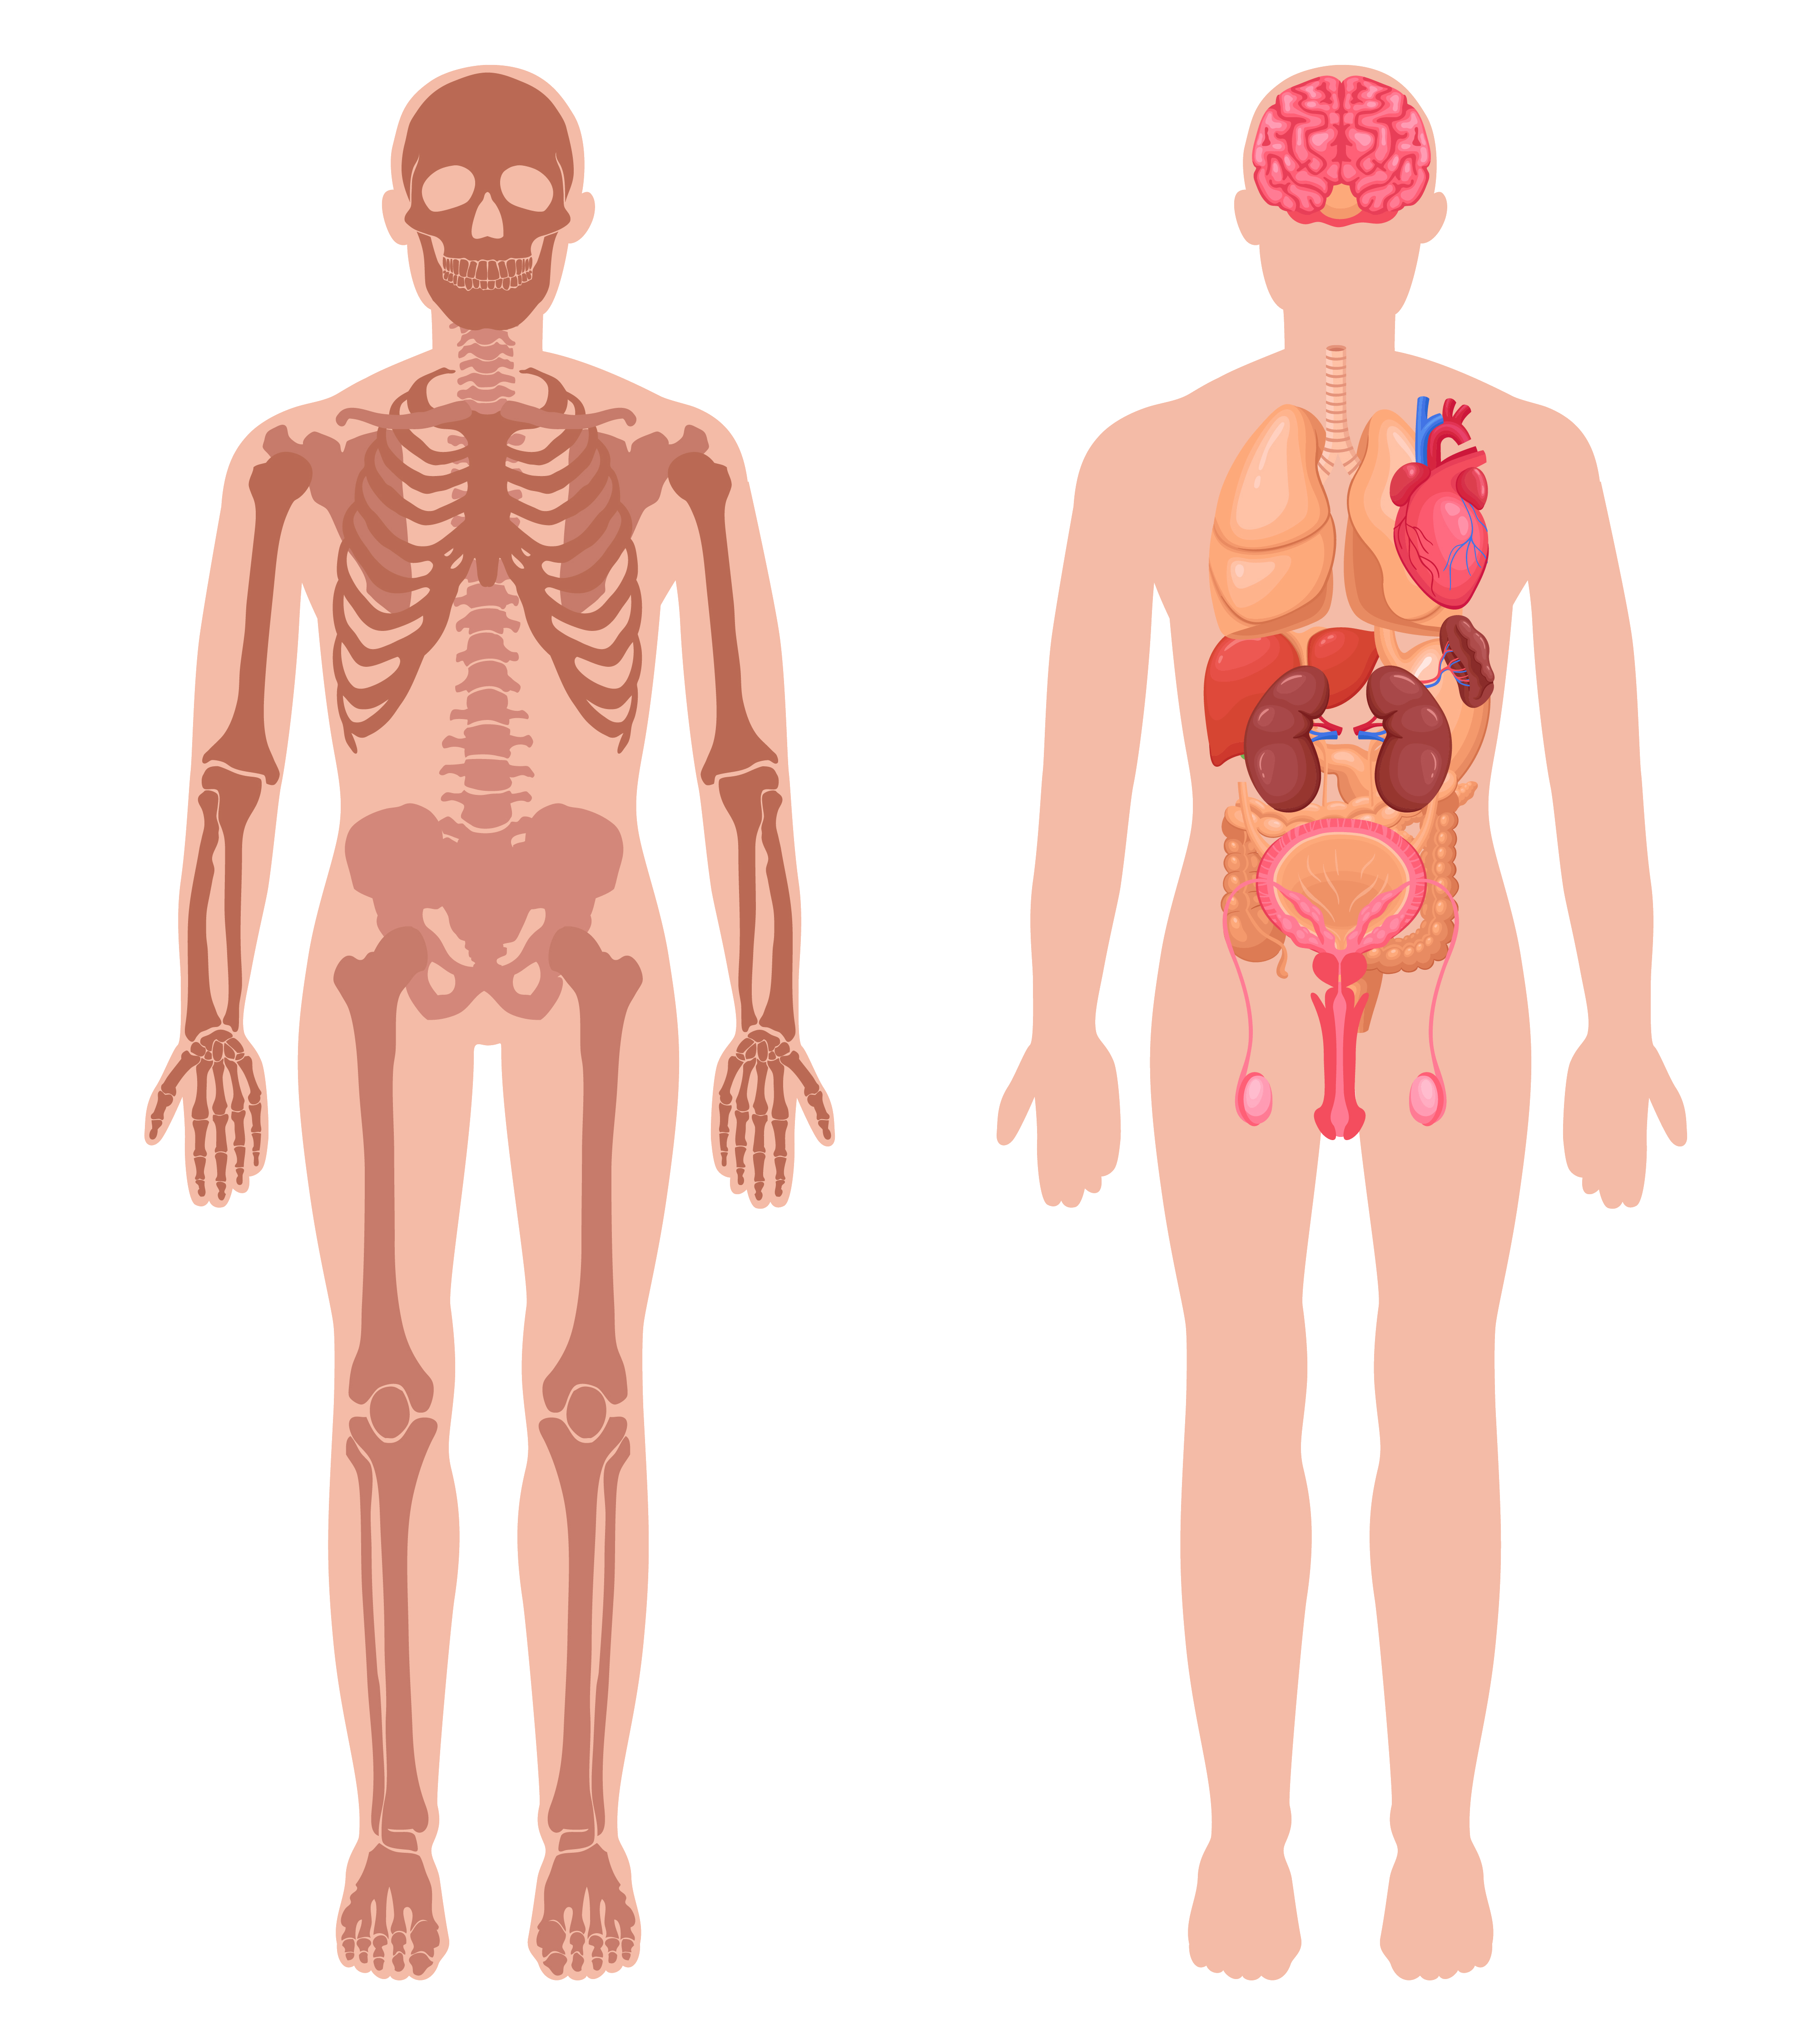
Integumentary System
Clinical Manifestations:
Compensatory Stage – Pale and cool or warm and flushed.
Progressive Stage – Cold and clammy.
Refractory Stage – Mottled appearance with cyanosis

Slide 10
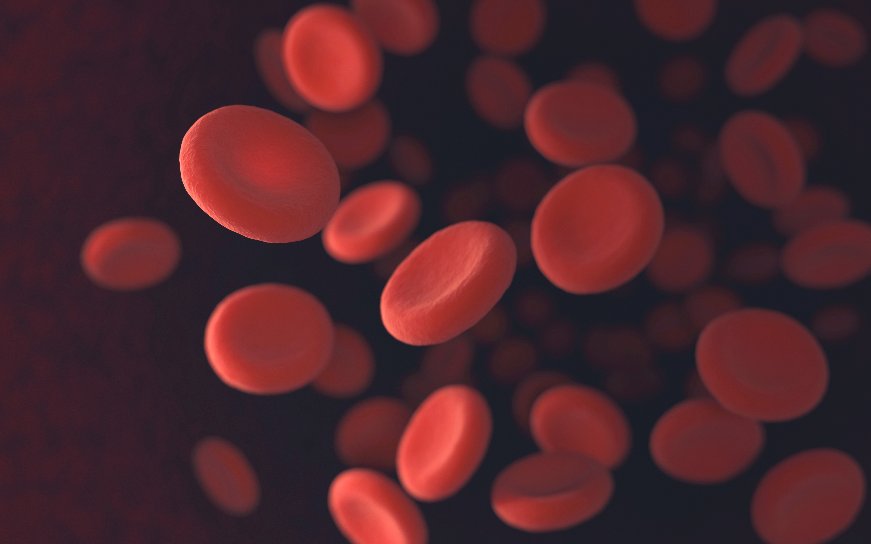
Labs
Lactate
ABGs
BUN, Creatinine,
Urine Specific Gravity
Liver Enzymes (ALT, AST, GGT)
Glucose

Slide 11
Nursing Management
Overall Goals:
MAP ≥65 mm Hg
Restore adequate tissue perfusion
Support organ function
Prevent complications
Key Interventions:
Neurological
Cardiovascular
Respiratory
Renal
Temperature
GI
Hygiene
Emotions

Slide 12
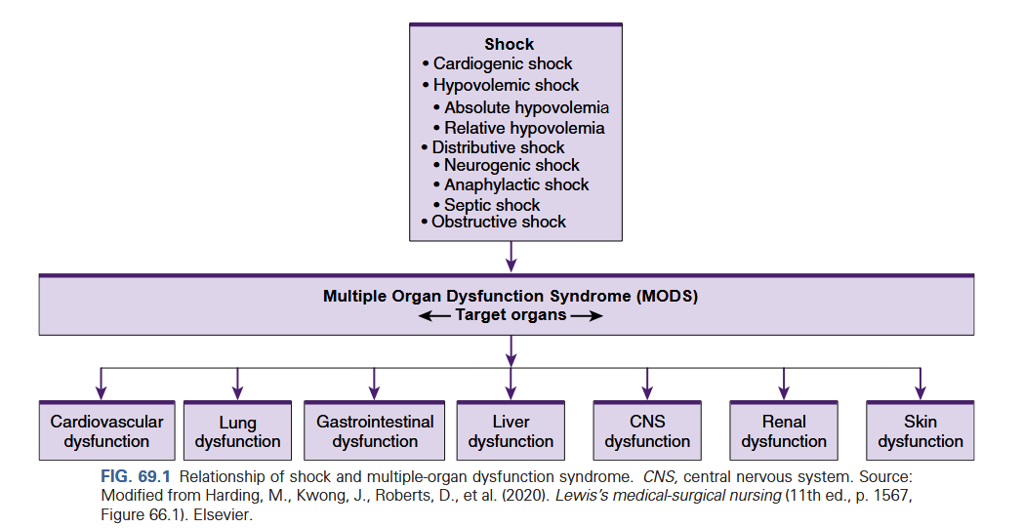
Complications
MODS (Multiple-Organ Dysfunction Syndrome)
ARDS (Acute Respiratory Distress Syndrome)

Slide 13
Part 2:
Case Study

